Slide 1
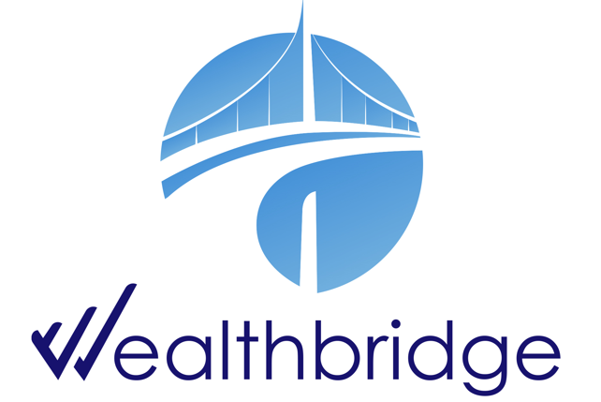
WEEKLY
BRIEF
24th November – 28th November 2025
Wealthbridge Economic Advisory

Slide 2
NEWS HIGHLIGHTS
Key Highlights During the Week
International News
Local News
United States: U.S. jobless claims hit lowest since April, Delayed data signal cooling U.S. consumer spending at end of Q3, US mortgage applications stabilize as home purchase demand surges
UK & Eurozone: Eurozone Inflation stabilizes, UK Retail sector faces steep decline, Government approves 4.1% Wage hike, unveils new tax increase.
China: Yuan Hits Strongest Level in Over a Year Amid Dollar Weakness Bets, Industrial Profit falls
Japan: Japan shows mixed signals amid low unemployment, rising inflation, and factory output uncertainty
South Africa: Producer inflation accelerates to 2.9% in South Africa; Rand gains on robust financial data
Ghana: Ghana cuts policy rate as inflation eases, economy accelerates on strong services growth
African Development Bank Group approves $500 million loan to support economic governance and energy transition
Nigeria retains key policy rate at 27%
Nigeria’s PMI hits 56.4 in November
Private sector credit surges by N1.89trn following September rate cut
NNPC reports N5tn revenue despite drop in crude output
Key Macroeconomic Indices
NAFEM (₦/$) | Monetary Policy Rate | Brent Crude oil price ($/Barrel) | Inflation Rate | GDP Growth Rate
N1,446.74/$1 (28/11/25) | 27.00% (Sep 2025) | $62.87 (28/11/25) | 16.05% (Nov 2025) | 4.23% (Q2 2025)

Slide 3
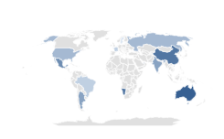

Global Economy
& Markets
The United States
U.S Jobless Claims hit lowest since April, Delayed data signal cooling consumer pending, Mortgage Applications stabilize
The Labor Department reported that initial claims for U.S. unemployment benefits came in at 216,000 for the week ended November 22, down from the prior week’s upwardly revised figure of 222,000 and marking the lowest reading since April. However, continuing claims increased by 7,000 to 1.960 million near the year peak.
Newly released September data show U.S. retail spending slowing to 0.2%, below expectations for 0.4%. Core spending categories were softer, with ex-auto and gas sales up just 0.1% and GDP-linked control group sales dipping 0.1%. Meanwhile, postponed PPI data revealed a 0.3% rise in wholesale inflation, with core PPI moving broadly in line with forecasts.
US mortgage applications rose slightly by 0.2% last week, holding most of the earlier 5.2% decline. Rising mortgage rates pushed refinancing applications down 5.7%, but demand for home purchase loans surged 7.6%, the strongest level since early 2023.
What to Expect
A slow softening of the labor market supports the Fed’s view that the economy is cooling but not collapsing while the slow consumer spending may lead to a slower GDP growth in the near term.
Source: Trading Economics, WealthBridge Research
Drivers
Indices’ Performance
Markets Climb on Dovish Fed Signals, Small caps and Tech Surge
Stocks rebounded this week from their largest pullback since April, driven by expectations of a December Fed rate cut and renewed optimism about long-term earnings in the AI sector, which lifted tech-heavy indices
S&P 500 | 6,849.09 | 3.72% ①
Nasdaq Composite | 23,365.69 | 4.9% ①
Dow Jones Industrial average | 47,716.42 | 3.2 % ①
U.S. stocks ended the holiday-shortened week higher, supported by dovish Fed signals and softer economic data that strengthened expectations for a December rate cut.
Small caps led gains, with the Russell 2000 up 5.52%, while the Nasdaq rebounded as AI valuation concerns eased amid renewed optimism over tech growth. Markets were closed Thursday for Thanksgiving.

Slide 4

Global Economy
& Markets
UK & Eurozone
Eurozone Inflation stables, UK Retail sector faces steep decline, Government approves 4.1% Wage hike, Unveils new tax increase
Regional data show subdued inflation in November, with France at 0.8% YoY, Spain easing to 3.1%, and Italy falling to 1.1%. These trends suggest eurozone-wide inflation data, due December 2, could remain near the ECB’s 2% target, with analysts expecting around 2.2%
The CBI retail sales balance fell to –32 in November, the lowest in 17 years, signaling a deepening contraction in UK retail activity. Retailers expect muted demand and slightly slower sales decline in December.
Britain's main minimum wage rate will rise by 4.1% to 12.71 pounds ($16.67) an hour from April 2026 following a hike of 6.7% earlier in the year. Benefiting 2.4 million workers aged 21 and over, workers below 21 will also see increases of 6%–8.5%.
UK unveils plans to raise taxes by £26 billion, marking a second consecutive year of hikes. The OBR project tax burden to reach 38% of GDP BY 2030 from 25% in 2025.
What to Expect
Subdued November inflation suggests the ECB may keep policy steady in the near term, provide some support
Tax hikes and weak retail sentiment in the UK may dampen spending, slowing economic growth in the medium term.
Source: Trading Economics, WealthBridge Research
European markets ended lower amid bubble concerns
Indices’ Performance
In local currency terms, the pan-European STOXX Europe 600 Index closed 2.35% higher.
Major single-country stock indexes rose as well. Germany’s DAX gained 3.23%, Italy’s FTSE MIB added 1.63%, and France’s CAC 40 Index was up 1.75%. The UK’s FTSE 100 Index climbed 1.97%.
Drivers
FTSE 100 | 9,720.51 | 1.97 % ①
DAX index | 23,836.79 | 3.23 % ①
CAC 40 | 8,122.71 | 1.75 % ①
FTSE MIB | 43,357 | 1.63% ①
Expectation of US rate cuts and continued earnings reports across European firms, combined with economic data from the eurozone and global developments.

Slide 5

Global Economy
& Markets
Asia
Yuan Hits Strongest Level in Over a Year Amid Dollar Weakness Bets, Industrial Profit falls
China’s central bank set the yuan’s daily fixing rate at 7.0796 per US dollar, the strongest since October 2024, following a 0.34% offshore rally when it briefly touched 7.0794. Analysts note the yuan has appreciated despite a firm US dollar and may continue to strengthen if the Federal Reserve cuts rates in December.
China’s industrial profits fell 5.5% YoY in October, following strong gains in the prior two months. The producer price index remained negative for the 37th consecutive month despite Beijing’s efforts to curb price wars and excess output. Analysts still expect China to achieve its official 2025 growth target of around 5%.
Mainland Chinese stocks rose, driven by investor enthusiasm for domestic tech and AI, despite growth slowdown concerns.
What to expect
A stronger yuan may ease import costs but could pressure China’s exporters
Markets may also price in more policy support, especially if economic signals remain soft.
Shanghai Composite | 3,888.60 | 1.40% ①
Hang Seng Index | 25858.89 | 2.53% ①
Nikkei 225 index | 50,253.91 | 3.35% ①
Japan Shows Mixed Signals Amid Low Unemployment, Rising Inflation, and Factory Output Uncertainty
Japan’s unemployment rate held at 2.6% in October, slightly above expectations of 2.5% and the highest since July 2024, as joblessness rose to 1.85 million. Labor force participation also improved as number of people outside the labor force fell by 150,000
Tokyo’s core inflation remained at 2.8% in November, above the BoJ’s 2% target and strengthening expectations of a potential rate hike. Strong October data on industrial production, retail sales, and steady unemployment signaled economic resilience and supported confidence in a more sustainable inflation trend.
Japan's factory output unexpectedly rose 1.4% in October from the previous month due to robust automobile production. but manufacturers expect industrial output to fall in coming months suggesting the hit from U.S. tariffs could intensify.
Outlook
Japan’s economy shows resilience but forward risks from U.S. tariffs and expected industrial slowdown may weigh on growth.

Slide 6
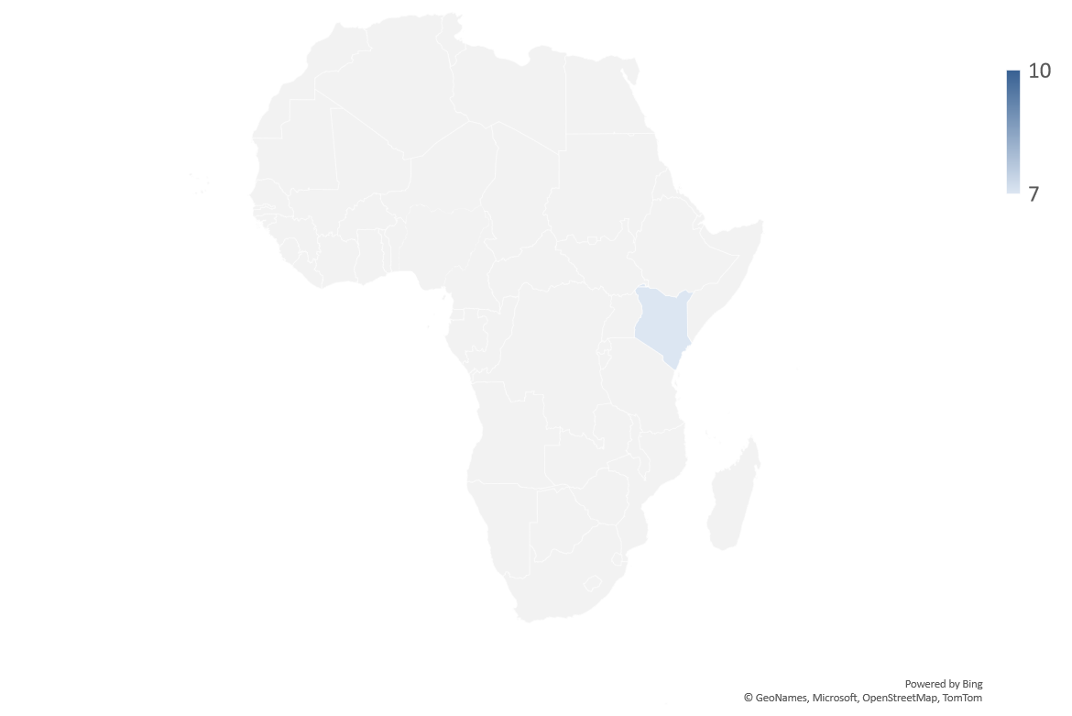


AFRICAN Economy
Producer Inflation Accelerates to 2.9% in South Africa; Rand Gains on Robust Financial Data
In October 2025, South Africa witnessed its fifth consecutive month of rising Producer Price Index (PPI) inflation, which reached 2.9%, marking its highest point since July 2024. This was an increase from September's rate of 2.3%, although it fell short of the anticipated 3.1%.
This was driven mainly by higher prices in food and beverages, petroleum-related products, and furniture manufacturing, while monthly PPI dipped 0.1% for the second consecutive month.
The South African rand strengthened to 17.11 per dollar after data showed improving liquidity and credit conditions, with M3 money supply rising to 7.52% and private sector credit growth accelerating to 7.26% in October, both above September levels and market forecasts.
Ghana Cuts Policy Rate as Inflation Eases; Economy Accelerates on Strong Services Growth
The Bank of Ghana lowered its policy rate by 350 bps to 18%, its third cut this year, citing a stronger macro-outlook as inflation fell to 8% in October within the target band and expected to ease to 4%–6% by year-end while economic growth remains solid.
In addition to the policy rate reduction, the bank will now return to the use of the 14-day treasury bill as its main instrument for conducting open market operations as a renewed effort to streamline market operations.
Ghana’s economy grew 5.1% in August 2025, led by a 9.6% expansion in the services sector, which contributed over 4 percentage points to the overall growth. Agriculture also supported growth with a 7.4% increase, while the industrial sector contracted by 1.08% due to weaker petroleum output, manufacturing, and declines in key service-related industries.

Slide 7

Domestic Economy and Markets Highlights
Snapshot of Key Macroeconomic Indicators
Indicators | Current | Previous
Inflation rate | 16.05% (Nov 2025) | 18.02% (Sep 2025) | ② 197 bps
MPR | 27.00% (Sep 2025) | 27.50% (July 2025) | ② 50 bps
Quarterly GDP Growth Rate | 4.23% (Q2 2025 y/y) | 3.13% (Q1 2025 y/y) | ❐ 110bps
Yearly GDP Growth Rate | 3.38% (FY 2024; y/y) | 3.04% (FY 2023; y/y) | ❐ 34 bps
GDP (Nominal) | N100.73 Trn (Q2 2025) | N94.051Trn (Q1 2025) | ❐ 7.10%
Brent Crude oil price | $62.87 (28/11/25) | $62.51 (21/11/25) | ❐ 0.58%
Exchange rate (NAFEM W-O-W% , N/$) | N1,446.74/$1 (28/11/25) | N1,457.38/$1 (21/11/25) | ② 0.73%
Parallel Market FX Rate (IMTO) (N/$) | N1,470.00/$1 (28/11/25) | N1,474.00/$1 (21/11/25) | ② 0.28%
P2P (N/$) | N1,475.00/$1 (28/11/25) | N1,479.00/$1 (21/11/25) | ② 0.27%
External Reserve | $44.606 billion (27/11/25) | $44.261 billion (21/11/25) | ❐ 0.78%

Slide 8

Domestic Economy and Markets Highlights
Key Fiscal News
African Development Bank Group Approves $500 million loan to support economic governance and energy transition
The Board of Directors of the African Development Bank Group, meeting in Abidjan, approved a $500 million loan to the Government of the Federal Republic of Nigeria to finance the second phase of the Economic Governance and Energy Transition Support Programme.
The second phase of the programme aims to stimulate inclusive growth by accelerating structural reforms in the energy sector, while supporting progressive reforms of fiscal policy to boost non-oil revenues and expand fiscal space.
The programme’s direct beneficiaries are the Federal Ministry of Power, the Federal Ministry of Finance, the Federal Inland Revenue Service, the Office of the Auditor General, the Debt Management Office, the National Climate Change Council of Nigeria (NCCC), the Federal Ministry of the Environment, the Nigerian Electricity Regulatory Commission (NERC), and other bodies responsible for social and economic policies.

Slide 9

Domestic Economy and Markets Highlights
Key Economic News
Nigeria Retains Key Policy Rate at 27%
The Central Bank of Nigeria held its benchmark rate at 27% on November 25, 2025, after a 50bps cut in September, citing the need to sustain progress on controlling inflation.
While headline inflation slowed for the seventh consecutive month to 16.05% in October, policymakers noted it remains elevated.
The CBN also kept other rates unchanged but adjusted the corridor around the MPR to +50/-450bps to support market stability.
Nigeria’s PMI hits 56.4 in November
Nigeria’s private sector continued its upward trajectory in November 2025, as the Composite Purchasing Managers’ Index (PMI) climbed to 56.4 index points, up from 55.4 in October. The CBN confirmed that the November PMI marked the twelfth consecutive month of expansion and reflected broad-based improvements across production, orders, employment, and supply chains.
The Output Index rose to 59.1 and New Orders to 56.7, while employment climbed to 54.4, reflecting rising demand. The Industry PMI held at 54.2 despite minor contractions in some subsectors, led by Water Supply and waste management. Services PMI remained strong at 56.8, driven by educational Services and other expanding subsectors. Agriculture continued as the top-performing sector with a PMI of 58.2, marking 16 months of growth.
Overall, sustained PMI readings above 55 signal a durable recovery, boosting investor confidence, job creation, and business performance.

Slide 10

Domestic Economy and Markets Highlights
Key Economic News
Private Sector Credit Surges by N1.89trn Following September Rate Cut
Credit to Nigeria’s private sector rose sharply in October 2025 to N74.41 trillion, up 2.6% month-on-month from September, marking the strongest monthly gain in 2025 following the CBN’s 50bps MPR cut.
On a year-on-year basis, growth was modest at 0.46%, indicating that while annual credit levels are near last year’s figures, the short-term rebound reflects improved liquidity and easing inflation conditions.
This trajectory shows that tight monetary conditions and liquidity swings held back private credit for much of the year, while the September rate cut appears to have triggered a fresh but still fragile lending impulse in October.
NNPC Reports N5tn Revenue Despite Drop in Crude Output
The Nigerian National Petroleum Company posted N5.07 trillion in revenue and N447 billion profit after tax in October 2025 even as the country’s crude oil and condensate production fell to its lowest point in 10 months.
The report, released on Saturday, said the country pumped 1.58 million barrels per day of crude oil and condensates in October, slipping down from 1.61mbpd in September.
NNPC Limited also announced its financial performance for the full year ended 2024, reporting a Profit After Tax of ₦5.4 trillion on revenue of ₦45.1 trillion. The results, shared during its earnings call with analysts, underscore a year of strong operational delivery.

Slide 11







Domestic Markets
Equities Market
The Nigerian Equities Market Ended The Week Bearish
Sectoral Performances
Market Capitalisation: N91.286 trn (② 0.14% W-o-W)
All Share Index: 143,520.53 (② 0.14% W-o-W)
Year-to-Date 39.44% (② 200 bps W-o-W)
Total Turnover (Trades): 2.668 bn (① 55.178% W-o-W)
Value of Trades: N115.889bn (① 9.06% W-o-W)
Fixed Income Market
Bond Market
Nigeria’s local bond market ended the week bearish as broad sell-offs pushed average FGN bond yields up by 14 bps to 15.61%, reflecting weak investor sentiment and low appetite for domestic fixed income. Trading remained selective, with activity concentrated in the 2034–2038 maturities. At the DMO auction, demand softened compared to the prior round despite N657.26 billion in subscriptions for the N460 billion offer, leading to higher stop rates of 15.90% and 16%. Meanwhile, Eurobonds outperformed, with average yields falling 33 bps to 7.43% week-on-week.
Top Gainers & Decliners
NTB and Money Markets
System liquidity strengthened significantly, rising to a net surplus of N1.96 trillion due to OMO maturities (N360bn) and FGN bond coupon inflows, boosting banks’ funding capacity. The MPC’s decision to hold rates while tightening the asymmetric corridor improved market confidence and spurred activity at CBN lending and deposit windows. As liquidity improved, money market rates fell sharply, Overnight NIBOR dropped 198bps, and short-tenor NIBORs also declined, while the OPR and Overnight rates eased to 22.50% and 22.71% respectively.
The average benchmark yield closed at 16.84%

Slide 12



For more info call:
+234 809 999 4372
E-mail address
info@wealthbridge.com.ng
Visit us at:
21, Bourdillon Road, Ikoyi, Lagos
100, Ademola Adetokunbo street, Wuse II, Abuja
Visit our website
www.wealthbridge.com,ng
6

